Slide 1
Data Mining & Business Intelligence
Module 4:Clustering

Slide 2
Index -
Lecture 20 – Cluster Analysis | 4
Lecture 21 - Partitioning Method | 16
Lecture 22 –Hierarchical Clustering | 29
Lecture 23 –Density Based Methods | 52

Slide 3
Lecture 20
Cluster Analysis

Slide 4
What is Cluster Analysis?
Cluster: A collection of data objects
  similar (or related) to one another within the same group
  dissimilar (or unrelated) to the objects in other groups
Cluster analysis
  Finding similarities between data according to the characteristics found in the data and grouping similar data objects into clusters
Unsupervised learning: no predefined classes
Typical applications
  As a stand-alone tool to get insight into data distribution
  As a preprocessing step for other algorithms
Lecture 20 –Cluster Analysis

Slide 5
Clustering: Application Examples
Biology: taxonomy of living things: kingdom, phylum, class, order, family, genus and species
Information retrieval: document clustering
Land use: Identification of areas of similar land use in an earth observation database
Marketing: Help marketers discover distinct groups in their customer bases, and then use this knowledge to develop targeted marketing programs
City-planning: Identifying groups of houses according to their house type, value, and geographical location
Climate: understanding earth climate, find patterns of atmospheric and ocean
Lecture 20 –Cluster Analysis

Slide 6
Considerations for Cluster Analysis
Partitioning criteria
  Single level vs. hierarchical partitioning (often, multi-level hierarchical partitioning is desirable)
Separation of clusters
  Exclusive (e.g., one customer belongs to only one region) vs. non-exclusive (e.g., one document may belong to more than one class)
Similarity measure
  Distance-based (e.g., Euclidian) vs. connectivity-based (e.g., density)
Clustering space
  Full space (often when low dimensional) vs. subspaces (often in high-dimensional clustering)
Lecture 20 –Cluster Analysis

Slide 7
Major Clustering Approaches
Partitioning approach:
  Construct various partitions and then evaluate them by some criterion
  Typical methods: k-means, k-medoids, CLARANS
Hierarchical approach:
  Create a hierarchical decomposition of the set of data (or objects) using some criterion
  Typical methods: Diana, Agnes, BIRCH, CAMELEON
Density-based approach:
  Based on connectivity and density functions
  Typical methods: DBSACN, OPTICS, DenClue
Grid-based approach:
  based on a multiple-level granularity structure
  Typical methods: STING, WaveCluster, CLIQUE
Lecture 13 –Cluster Analysis

Slide 8
Lecture 21
Partitioning Method

Slide 9
Partitioning Methods
Partitioning method: Partitioning a database D of n objects into a set of k clusters, such that the sum of squared distances is minimized (where c_{i} is the centroid or medoid of cluster C_{i})
Global optimal: exhaustively enumerate all partitions
Heuristic methods: k-means and k-medoids algorithms
  Construct various partitions and then evaluate them by some criterion
  methods:
  k-means
  k-medoids
  CLARANS
Lecture 21 –Partitioning Methods

Slide 10
The K-Means Clustering Method
Given k, the k-means algorithm is implemented in four steps:
  Partition objects into k nonempty subsets
  Compute seed points as the centroids of the clusters of the current partitioning (the centroid is the center, i.e., mean point, of the cluster)
  Assign each object to the cluster with the nearest seed point
  Go back to Step 2, stop when the assignment does not change
Lecture 21 –Partitioning Methods

Slide 11





An Example of K-Means Clustering
K=2
Arbitrarily partition objects into k groups
Update the cluster centroids
The initial data set
Loop if needed
Partition objects into k nonempty subsets
Repeat
  Compute centroid (i.e., mean point) for each partition
  Assign each object to the cluster of its nearest centroid
Until no change
Reassign objects
Update the cluster centroids
Lecture 21 –Partitioning Methods

Slide 12
What Is the Problem of the K-Means Method?
The k-means algorithm is sensitive to outliers !
  Since an object with an extremely large value may substantially distort the distribution of the data
K-Medoids: Instead of taking the mean value of the object in a cluster as a reference point, medoids can be used, which is the most centrally located object in a cluster
Lecture 21 –Partitioning Methods

Slide 13
Difference between K means and K mediods
Both the k-means and k-medoids algorithms are partitional (breaking the dataset up into groups).
K-means attempts to minimize the total squared error, while k-medoids minimizes the sum of dissimilarities between points labeled to be in a cluster and a point designated as the center of that cluster.
In contrast to the k-means algorithm, k-medoids chooses data points as centers ( medoids or exemplars).
A mediod can be defined as the object of a cluster whose average dissimilarity to all the objects in the cluster is minimal. I.e., it is a most centrally located point in the cluster.
Lecture 21 –Partitioning Methods

Slide 14
K mediods algorithm
PAM, a k-medoids algorithm for partitioning based on medoid or central objects.
Input: k: the number of clusters,
D: a data set containing n objects.
Output: A set of k clusters.
Method: (1) arbitrarily choose k objects in D as the initial representative objects or seeds;
(2) repeat
(3) assign each remaining object to the cluster with the nearest representative object;
(4) randomly select a nonrepresentative object, orandom;
(5) compute the total cost, S, of swapping representative object, oj , with orandom;
(6) if S < 0 then swap oj with orandom to form the new set of k representative objects;
(7) until no change;
Lecture 21 –Partitioning Methods

Slide 15
CLARA((Clustering LARge Applications)
k-medoids partitioning algorithm like PAM works effectively for small data sets, but does not scale well for large data sets.
To deal with larger data sets, a sampling-based method called CLARA (Clustering LARge Applications) can be used.
Instead of taking the whole data set into consideration, CLARA uses a random sample of the data set.
The PAM algorithm is then applied to compute the best medoids from the sample.
Ideally, the sample should closely represent the original data set. In many cases, a large sample works well if it is created so that each object has equal probability of being selected into the sample.
Lecture 21 –Partitioning Methods

Slide 16
CLARA((Clustering LARge Applications)
The representative objects (medoids) chosen will likely be similar to those that would have been chosen from the whole data set.
CLARA builds clusterings from multiple random samples and returns the best clustering as the output.
The complexity of computing the medoids on a random sample is O(ks2 + k(n − k)), where s is the size of the sample, k is the number of clusters, and n is the total number of objects. CLARA can deal with larger data sets than PAM.
Lecture 21 –Partitioning Methods

Slide 17
Lecture 22
Hierarchical Method

Slide 18
Hierarchical Clustering
Use distance matrix as clustering criteria. This method does not require the number of clusters k as an input, but needs a termination condition
Step 0
Step 1
Step 2
Step 3
Step 4
agglomerative
(AGNES)
(Bottom Up Approach)
a
a b
b
a b c d e
c
c d e
d
d e
divisive
(DIANA)
(Top Down Approach)
e
Step 4
Step 3
Step 2
Step 1
Step 0
Lecture 22 – Hierarchical Method

Slide 19
Agglomerative Hierarchical Clustering
Given a set of n instances to be clustered, and an nxn distance (or similarity) matrix, the basic process hierarchical clustering is:
1 Start by assigning each item to its own cluster, so that if you have N items, you now have N clusters, each containing just one item.
Let the distances (similarities) between the clusters equal the distances (similarities) between the items they contain.
2 .Find the closest (most similar) pair of clusters and merge them into a single cluster, so that now you have one less cluster.
3. Compute distances (similarities) between the new clusters and each of the old clusters.
4. Repeat steps 2 and 3 until all items are clustered into a single cluster of size n.
Lecture 22 – Hierarchical Method

Slide 20
More on Hierarchical Clustering Methods
Major weakness of agglomerative clustering methods
  do not scale well: time complexity of at least O(n²), where n is the total number of instances
  can never undo what was done previously
Integration of hierarchical with distance-based clustering
  BIRCH (1996): uses CF-tree and incrementally adjusts the quality of sub-clusters
  CURE (1998): selects well-scattered points from the cluster and then shrinks them towards the center of the cluster by a specified fraction
  CHAMELEON (1999): hierarchical clustering using dynamic modeling
Lecture 22 – Hierarchical Method

Slide 21

AGNES (Agglomerative Nesting)
Introduced in Kaufmann and Rousseeuw (1990)
Implemented in statistical analysis packages, e.g., Splus
Use the Single-Link method and the dissimilarity matrix.
Merge nodes that have the least dissimilarity
Go on in a non-descending fashion
Eventually all nodes belong to the same cluster
Lecture 22 – Hierarchical Method

Slide 22
Dendogram
  Decompose data objects into a several levels of nested partitioning (tree of clusters), called a dendrogram.
  A clustering of the data objects is obtained by cutting the dendrogram at the desired level, then each connected component forms a cluster.
Lecture 22 – Hierarchical Method

Slide 23
A Dendrogram Shows How the Clusters are Merged Hierarchically
Lecture 22 – Hierarchical Method

Slide 24
DIANA (Divisive Analysis)
Introduced in Kaufmann and Rousseeuw (1990)
Implemented in statistical analysis packages, e.g., Splus
Inverse order of AGNES
Eventually each node forms a cluster on its own
Lecture 22 – Hierarchical Method

Slide 25
Computing Inter-Cluster Distances
single-link clustering (also called the connectedness or minimum method) : we consider the distance between one cluster and another cluster to be equal to the shortest distance from any member of one cluster to any member of the other cluster. If the data consist of similarities, we consider the similarity between one cluster and another cluster to be equal to the greatest similarity from any member of one cluster to any member of the other cluster.
complete-link clustering (also called the diameter or maximum method): we consider the distance between one cluster and another cluster to be equal to the longest distance from any member of one cluster to any member of the other cluster.
average-link clustering : we consider the distance between one cluster and another cluster to be equal to the average distance from any member of one cluster to any member of the other cluster.
Lecture 22 – Hierarchical Method

Slide 26
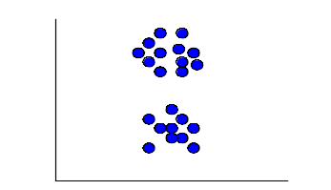
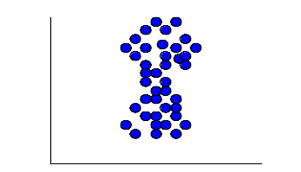
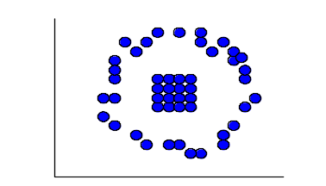
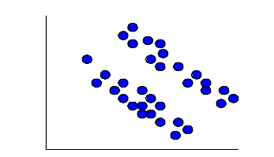
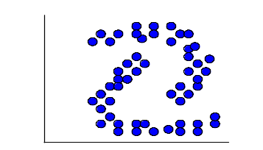
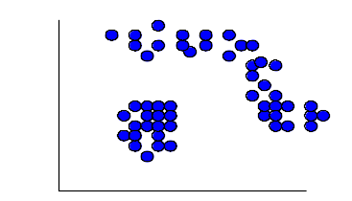
Computing Inter-Cluster Distances
Min
distance
Average
distance
Max
distance
Single-Link Method / Nearest Neighbor
Complete-Link / Furthest Neighbor
Their Centroids.
Average of all cross-cluster pairs.
Lecture 22 – Hierarchical Method

Slide 27
Determine the Number of Clusters
Empirical method
  # of clusters: k ≈√n/2 for a dataset of n points, e.g., n = 200, k = 10
Other methods:
  Elbow method
  Cross validation method
Lecture 15 -Hierarchical Method

Slide 28
Measuring Clustering Quality
3 kinds of measures: External, internal and relative
External: supervised, employ criteria not inherent to the dataset
  Compare a clustering against prior or expert-specified knowledge using certain clustering quality measure
Internal: unsupervised, criteria derived from data itself
  Evaluate the goodness of a clustering by considering how well the clusters are separated, and how compact the clusters are, e.g., Silhouette coefficient
Relative: directly compare different clusterings, usually those obtained via different parameter settings for the same algorithm
Lecture 15 -Hierarchical Method

Slide 29
Lecture 23
BIRCH (Balanced Iterative Reducing and Clustering using Hierarchies

Slide 30
BIRCH (Balanced Iterative Reducing and Clustering using Hierarchies)
It is a scalable clustering method.
Designed for very large data sets
Only one scan of data is necessary
It is based on the notation of CF (Clustering Feature) a CF Tree.
CF tree is a height balanced tree that stores the clustering features for a hierarchical clustering.
Cluster of data points is represented by a triple of numbers (N,LS,SS) Where
N= Number of items in the sub cluster
LS=Linear sum of the points
SS=sum of the squared of the points
Lecture 23 –BIRCH

Slide 31
BIRCH (Balanced Iterative Reducing and Clustering using Hierarchies)
A CF Tree structure is given as below:
Each non-leaf node has at most B entries.
Each leaf node has at most L CF entries which satisfy threshold T, a maximum diameter of radius
P(page size in bytes) is the maximum size of a node
Compact: each leaf node is a subcluster, not a data point
Lecture 23 –BIRCH

Slide 32
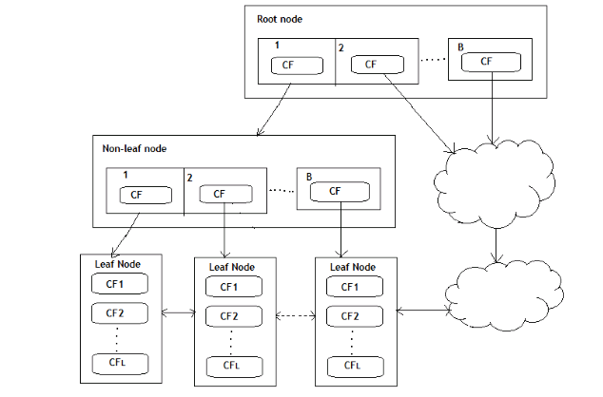
CF Tree Structure
Lecture 23 –BIRCH

Slide 33
Basic Algorithm:
Phase 1: Load data into memory
  Scan DB and load data into memory by building a CF tree. If memory is exhausted rebuild the tree from the leaf node.
Phase 2: Condense data(Compress Data)
  Resize the data set by building a smaller CF tree
  Remove more outliers
  Condensing is optional
Phase 3: Global clustering
  Use existing clustering algorithm (e.g. KMEANS, HC) on CF entries
Phase 4: Cluster refining
  Refining is optional
  Fixes the problem with CF trees where same valued data points may be assigned to different leaf entries.
Lecture 23 –BIRCH

Slide 34
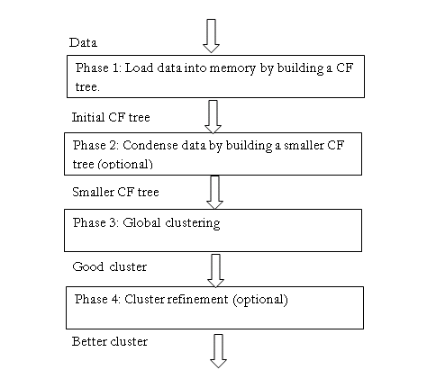
Basic Algorithm:
Lecture 23 –BIRCH

Slide 35
Example
Example:
Clustering feature:
CF= (N, LS, SS)
N: number of data points
LS: ∑Ni=1=Xi
Lecture 23 –BIRCH

Slide 36
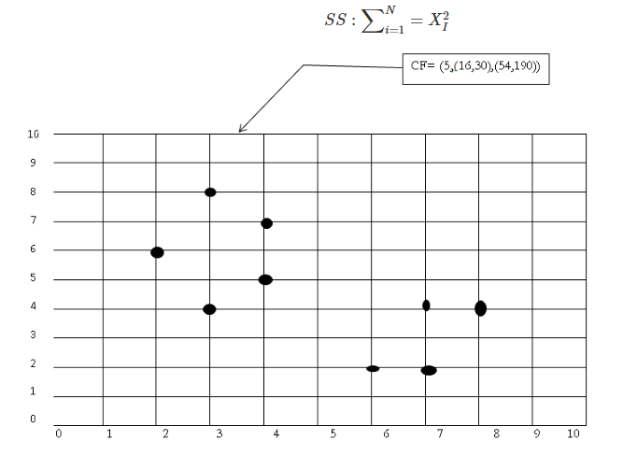
Example
(3,4) (2,6)(4,5)(4,7)(3,8)
N=5
NS= (16, 30 ) i.e. 3+2+4+4+3=16 and 4+6+5+7+8=30
SS=(54,190)=32+22+42+42+32=54 and 42+62+52+72+82=190
Lecture 23 –BIRCH

Slide 37
Advantages and Disadvantages
Advantages: Finds a good clustering with a single scan and improves the quality with a few additional scans
Disadvantages: Handles only numeric data
Applications:
  Pixel classification in images
  Image compression
  Works with very large data sets
Lecture 23 –BIRCH

Slide 38
Lecture 17
Density Based Clustering

Slide 39
DBSCAN
DBSCAN is a density-based algorithm.
DBSCAN requires two parameters: epsilon (Eps) and minimum points (MinPts).
It starts with an arbitrary starting point that has not been visited .
It then finds all the neighbour points within distance Eps of the starting point.
If the number of neighbours is greater than or equal to MinPts, a cluster is formed.
The starting point and its neighbours are added to this cluster and the starting point is marked as visited.
The algorithm then repeats the evaluation process for all the neighbours recursively.
Lecture 15 -Hierarchical Method

Slide 40
DBSCAN
If the number of neighbours is less than MinPts, the point is marked as noise.
If a cluster is fully expanded (all points within reach are visited) then the algorithm proceeds to iterate through the remaining unvisited points in the dataset.
Lecture 15 -Hierarchical Method

Slide 41
Major features:
Discover clusters of arbitrary shape
Handle noise
One scan
Need density parameters
Lecture 15 -Hierarchical Method

Slide 42
Basic concept:
For any cluster we have:
  A central point (p) i.e. core point
  A distance from the core point(Eps)
  Minimum number of points within the specified distance (MinPts)
Lecture 15 -Hierarchical Method

Slide 43
DBSCAN Algorithm
Create a graph whose nodes are the points to be clustered
For each core-point c create an edge from c to every point p in the -neighborhood of c
Set N to the nodes of the graph;
If N does not contain any core points terminate
Pick a core point c in N
Let X be the set of nodes that can be reached from c by going forward;
  a. create a cluster containing X∪∪{c}
  b. N=N/(X ∪∪ {c})
Continue with step 4
Lecture 15 -Hierarchical Method

Slide 44
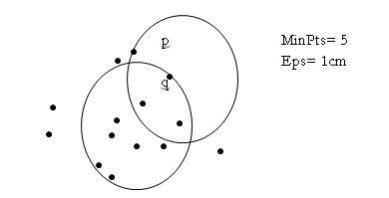
DBSCAN Algorithm
MinPts: Minimum number of points in any cluster
ϵϵ : For each point in cluster there must be another point in it less than this distance away.
-neighborhood: Points within  distance of appoint
N ϵϵ(p) :{q belongs to D |dist(p,q) <=ϵϵ)
Core point: ϵϵ- neighborhood dense enough (MinPts)
Conditions: p belongs to N ϵϵ(q)
|Nϵϵ(q)| > = MinPts
Lecture 15 -Hierarchical Method

Slide 45
Density-Based Clustering Methods
Clustering based on density (local cluster criterion), such as density-connected points or based on an explicitly constructed density function
Major features:
  Discover clusters of arbitrary shape
  Handle noise
  One scan
  Need density parameters
Several interesting studies:
  DBSCAN: Ester, et al. (KDD’96)
  DENCLUE: Hinneburg & D. Keim (KDD’98/2006)
  OPTICS: Ankerst, et al (SIGMOD’99).
  CLIQUE: Agrawal, et al. (SIGMOD’98)

Slide 46
Density-Based Clustering Methods
DBSCAN is a density-based algorithm.
  Density = number of points within a specified radius r (Eps)
  A point is a core point if it has more than a specified number of points (MinPts) within Eps
    These are points that are at the interior of a cluster
  A border point has fewer than MinPts within Eps, but is in the neighborhood of a core point
  A noise point is any point that is not a core point or a border point.

Slide 47

DBSCAN: Core, Border, and Noise Points

